Slide 1

Very low exposure simulator
Robin Jenkin | Ujwala Patil | April 2024

Slide 2
Problem Statement
Very low exposure simulator: Use Monte Carlo to generate very low exposure images

Slide 3
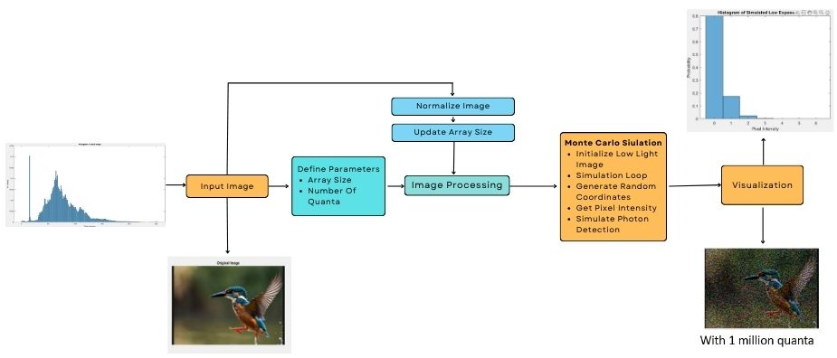
Methodology

Slide 4
Methodology
1. Define Parameters:
array_size: An initial estimate for the image size (e.g., 64x64). This value will be updated later based on the actual image dimensions.
number_of_quanta: The number of photons to simulate in the Monte Carlo simulation. More quanta lead to a more accurate simulation but take longer to process.
2. Image Preprocessing
2.1. Normalize Image: The image will be normalized by dividing each pixel intensity by 255. This converts the intensity values from the range [0, 255] to the range [0, 1].
2.2. Update Array Size: The array_size parameter will be adjusted to match the larger dimension (height or width) of the normalized image.

Slide 5
Methodology
3. Monte Carlo Simulation
3.1. Initialize Low Light Image: A new array ll will be created to store the simulated low light image. This array will have the same dimensions as the normalized image and will be initialized with zeros.
3.2. Simulation Loop: The program’s core is a loop that iterates number_of_quanta times. Each iteration represents a simulated photon.
Generate Random Coordinates: Two random values (x and y) will be generated within the valid range of the image dimensions to represent the location of the simulated photon hitting the image sensor.
Get Pixel Intensity: The normalized intensity value (p) at the corresponding coordinates (x, y) in the normalized image will be retrieved. This value represents the probability of a photon being detected at that pixel location.
Simulate Photon Detection: A random number (n) between 0 and 1 will be generated. If n is less than or equal to p, it is considered that a photon hit that pixel. The corresponding element in the ll array will be incremented by 1 to represent the simulated photon count for that pixel.

Slide 6
Methodology
4. Postprocessing and Visualization:
4.1. After the simulation completes, the "low light image" array will represent the simulated image with noise characteristics reflecting the very low exposure conditions.
4.2. This simulated low light image and the original image will be displayed side-by-side for visual comparison.
This methodology utilizes a computationally efficient approach to model the stochastic nature of photon arrivals in low light scenarios. By adjusting the number_of_quanta parameter, users can control the trade-off between simulation accuracy and computational time. The resulting simulated image can be used for various applications, including training image processing algorithms for low light conditions or visualizing the impact of limited lighting on image quality.

Slide 7
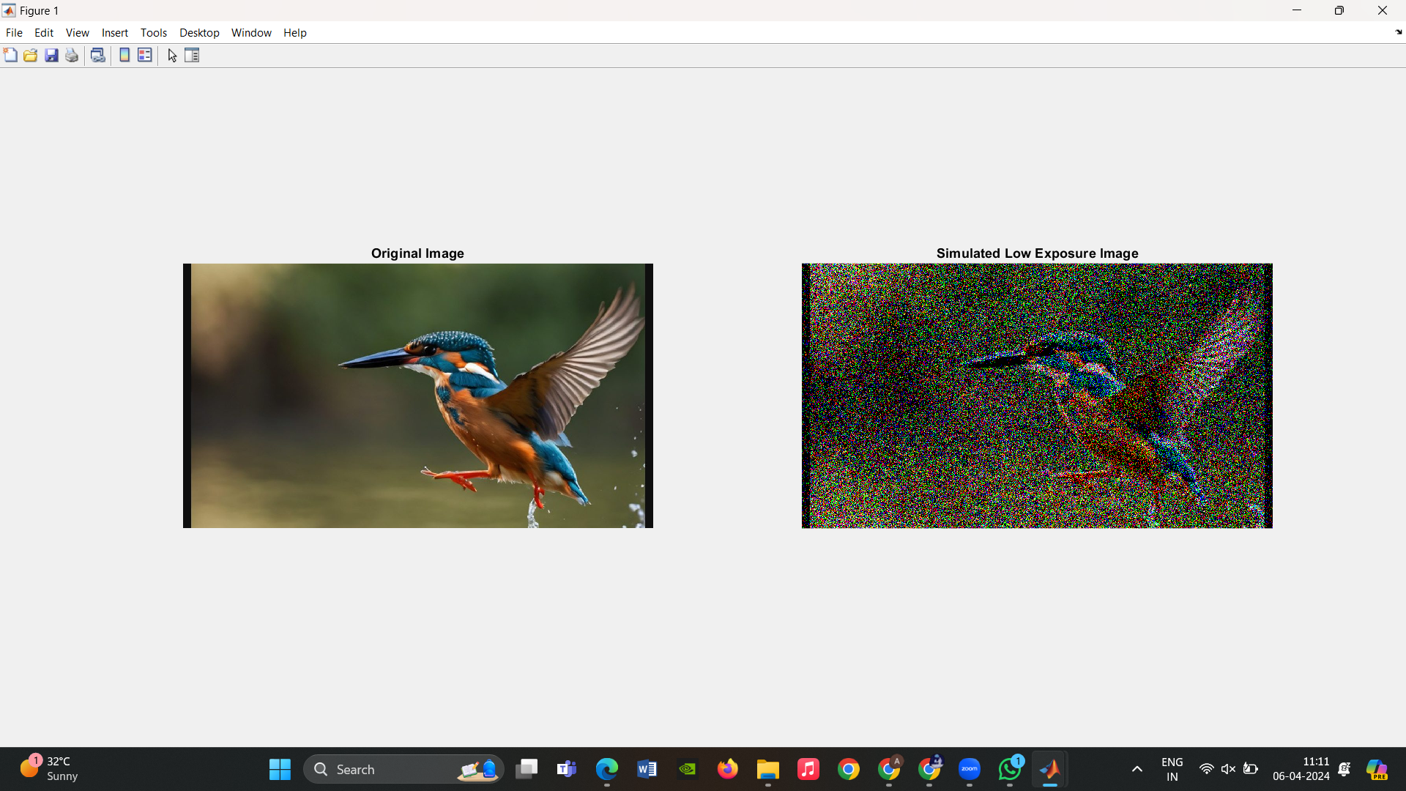
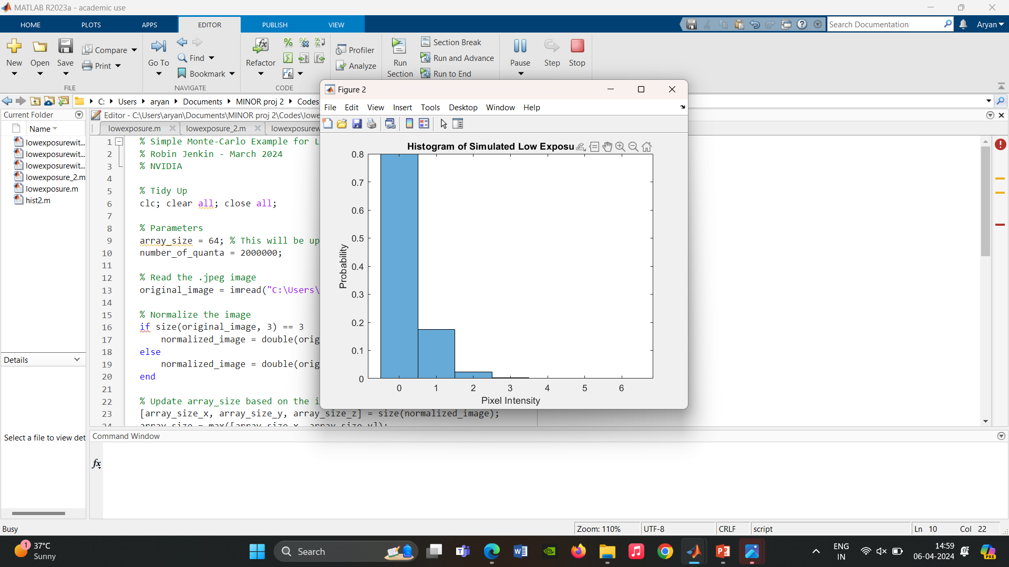
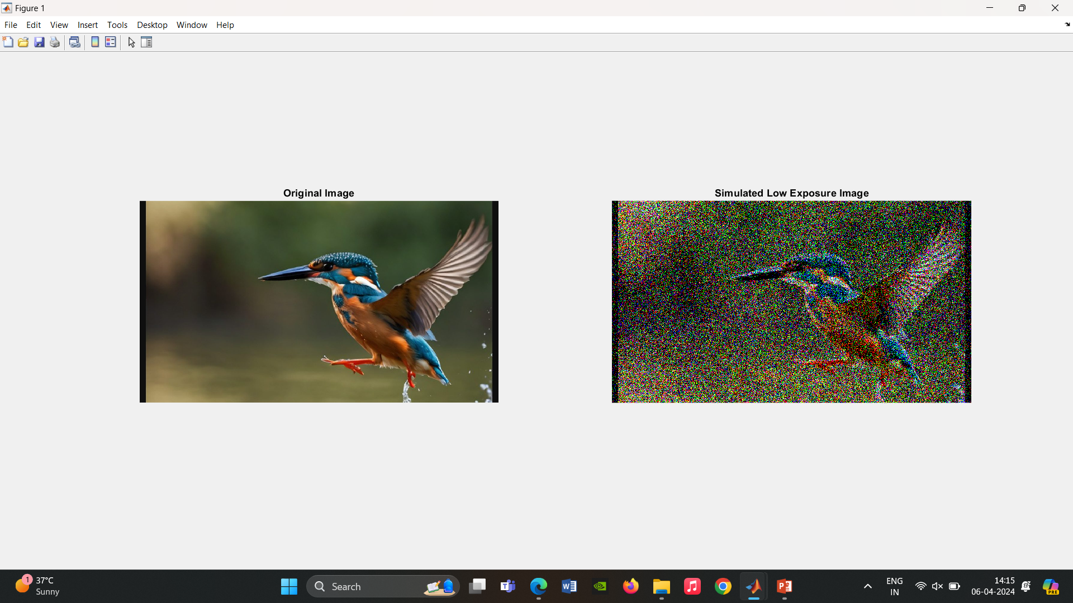
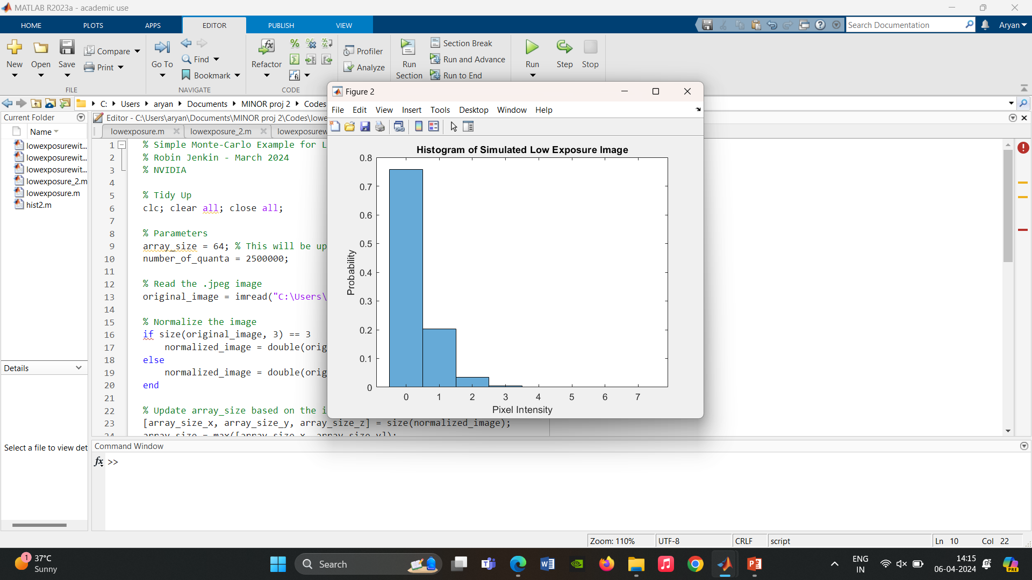
Input image
With 1 million quanta
With 2.5 million quanta

Slide 8
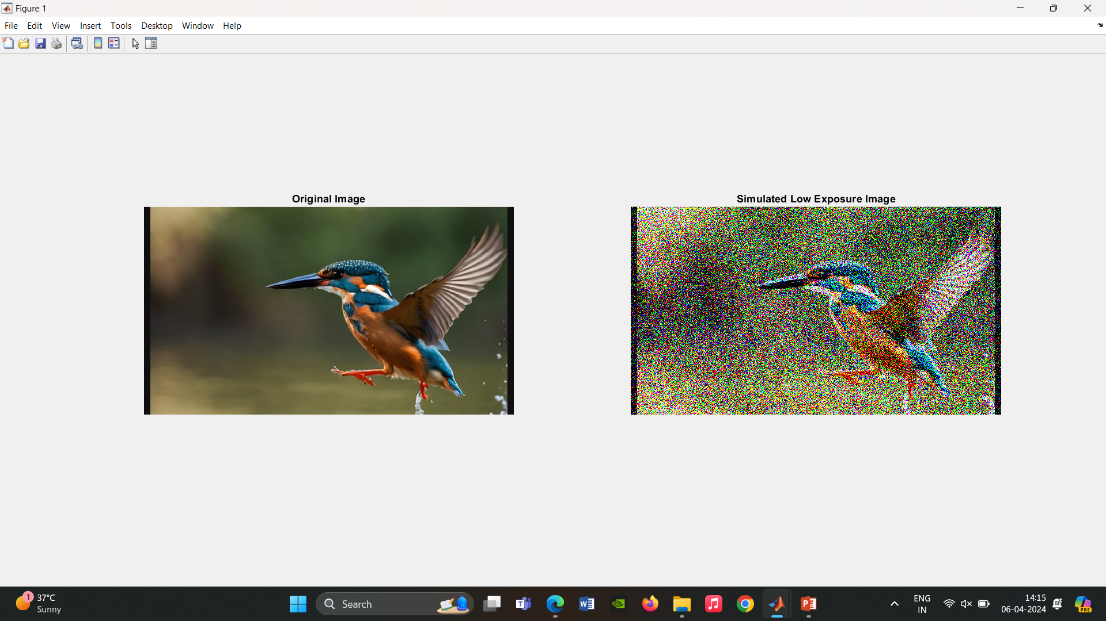
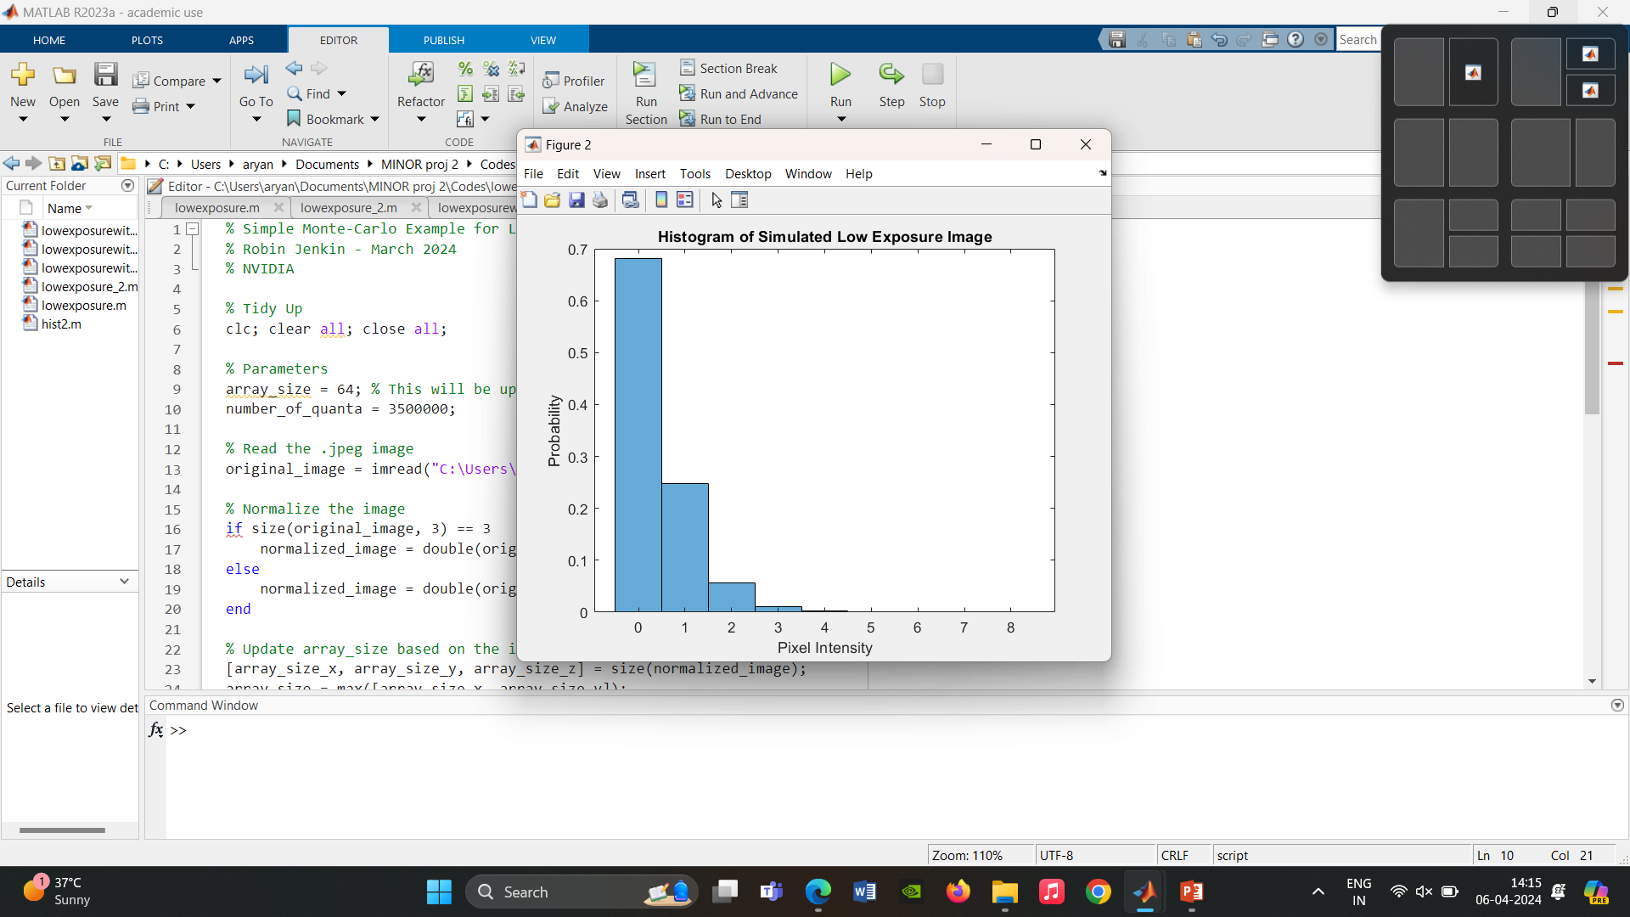
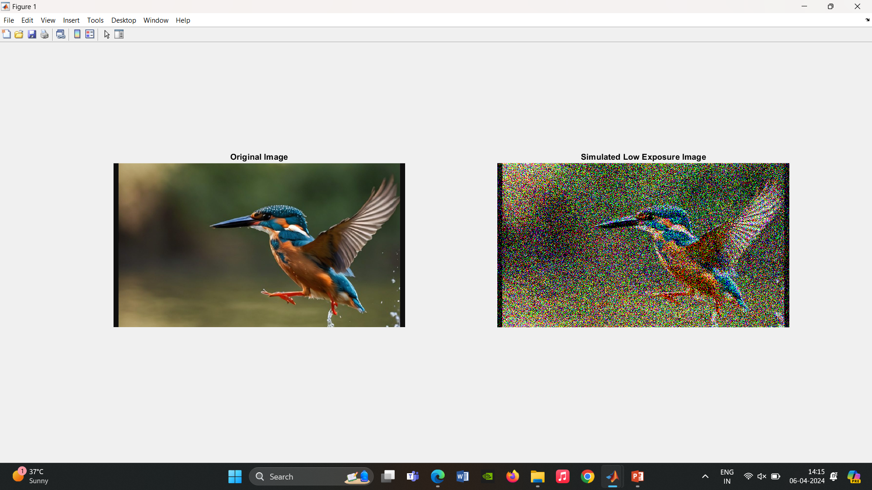
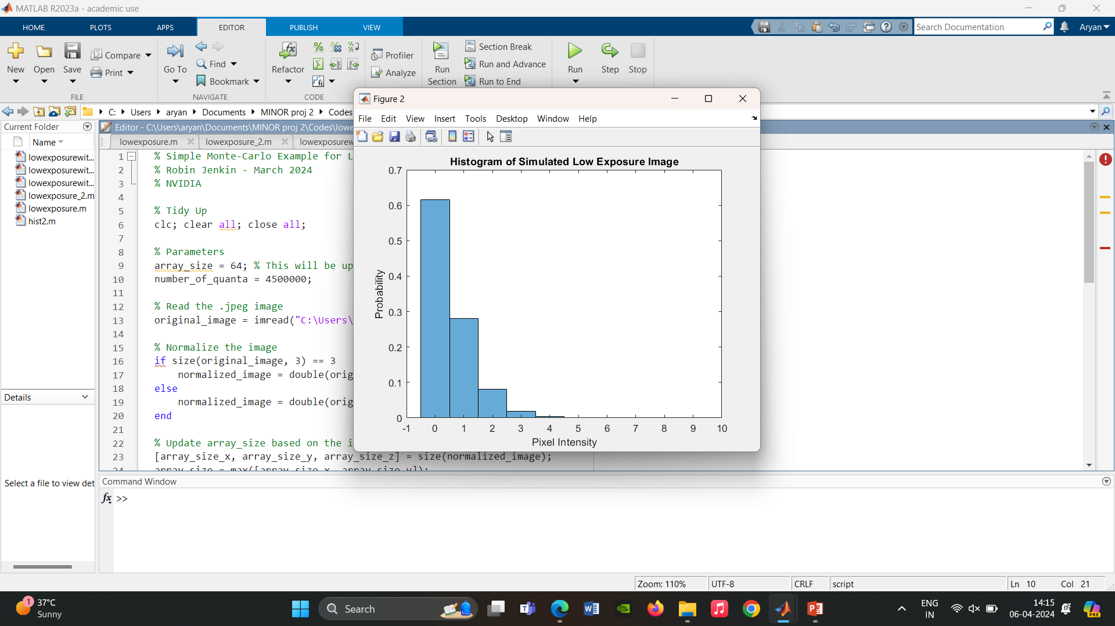
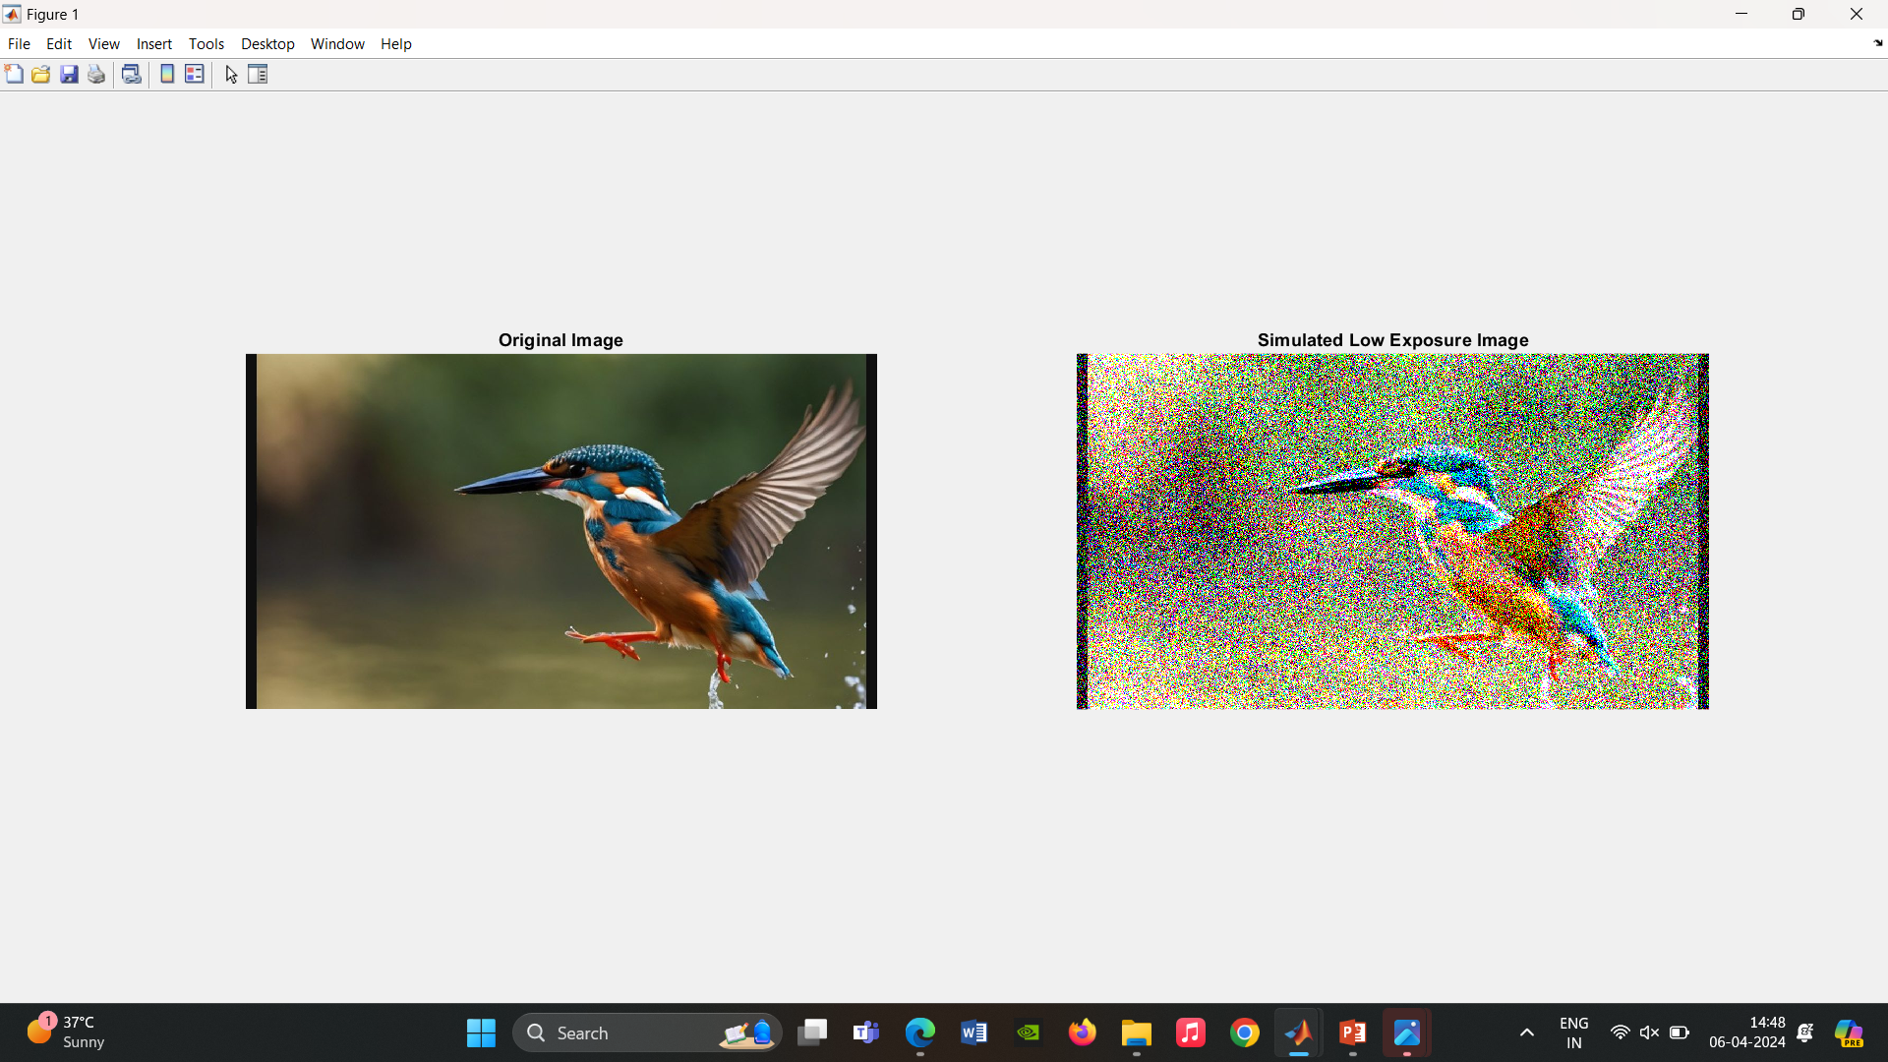
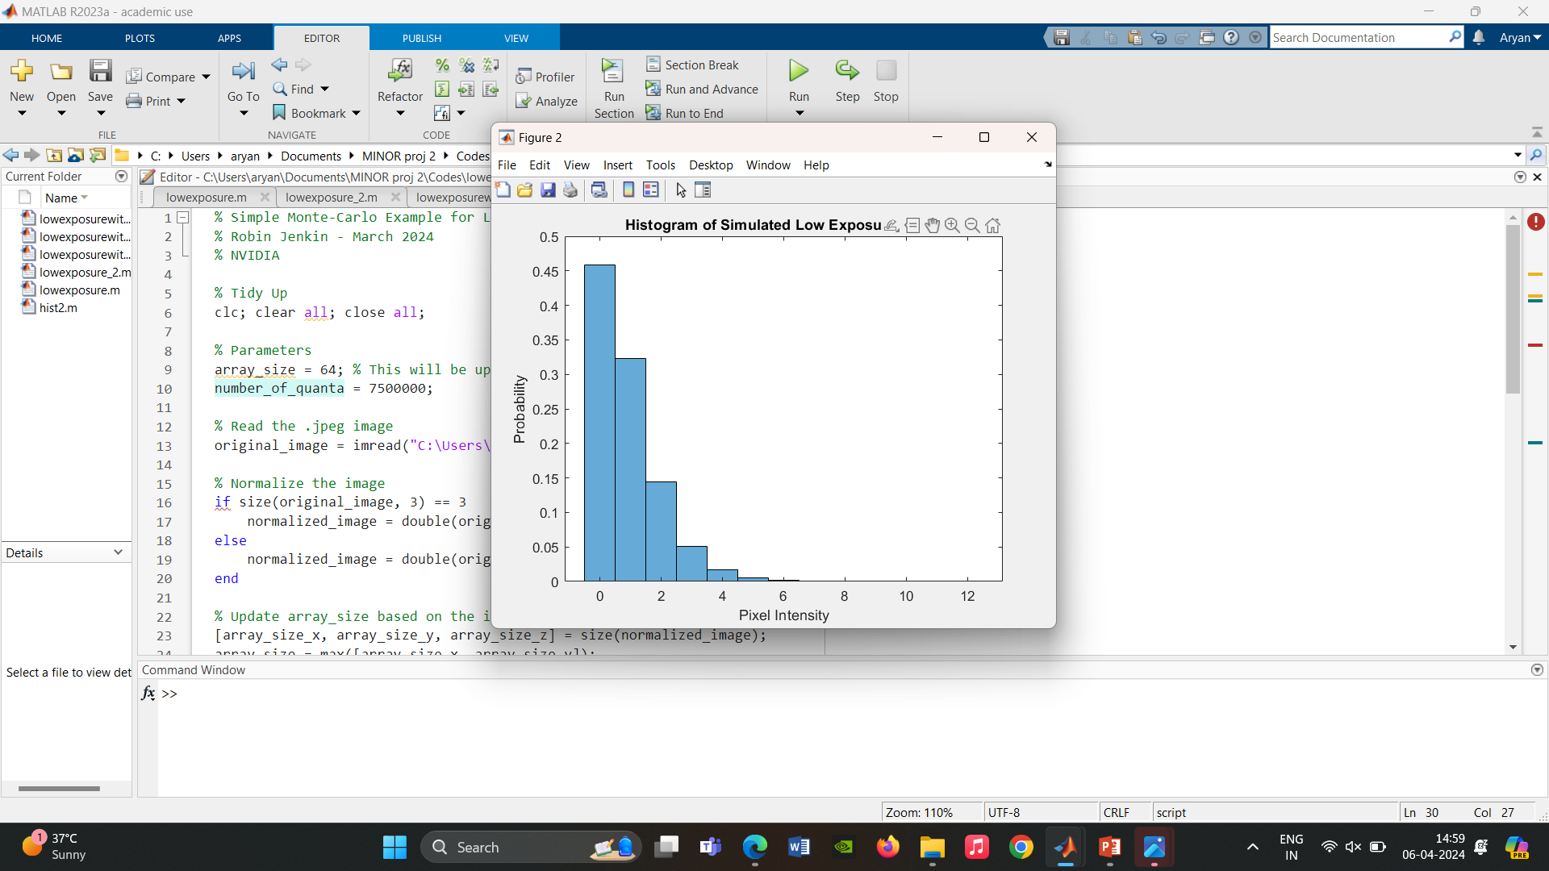
With 3.5 million quanta
With 4.5 million quanta
With 7.5 million quanta

Slide 9
Action Items
Write a Generalized function that can detect the number of channels in the image
Consider a particular channel (1 or 3) image and then “expose” it to n quanta per pixel - such that “white” would be an average of n quanta.

Slide 10
References
On the Application of the Modulation Transfer Function to Discrete Imaging Systems Robin Brian Jenkin B.Sc. (Hons), M.Res
Introduction To Monte Carlo Simulation - Samik Raychaudhuri

